Slide 1

Module 1
SIEM

Slide 2
What is SIEM
SIEM stands for Security Information and Event Manager
Real time analysis of security alerts / logs generated by applications and network hardware

Slide 3
What is SIEM
SOAR stands for Security Orchestration Automation Response
Automated event response, ex. A rule might trigger when there are > 20 failed login attempts in a short amount of time, resulting in the IP being blocked automatically

Slide 4
What is SIEM
UEBA stands for User and Event Behavioral Analytics
Compares real time network and application data to baselines to identify abnormalities

Slide 5
What is SIEM
SIP stands for Security Intelligence Platform
Combines SIEM, SOAR, and UEBA
Manual log monitoring gets messy quickly. SIEM is meant to make it possible for companies to monitor logs that are generated from thousands of nodes in real time.

Slide 6
What is SIEM
Required by data security policies, ex. Payment Card Industry Data Security Standard (PCI DSS)
“Audit logs must exist for all system components. Audit logs send alerts the system administrator, provides data to other monitoring mechanisms, such as intrusion-detection systems (IDS) and security information and event monitoring systems (SIEM) tools, and provide a history trail for post-incident investigation. Logging and analyzing security-relevant events enable an organization to identify and trace potentially malicious activities. (p. 215 Payment Card Industry Data Security Standard)

Slide 7
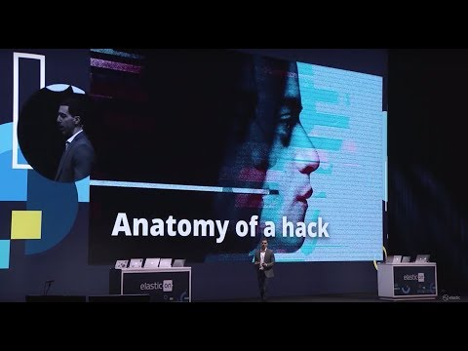
Using Elasticsearch & Kibana for Security Analytics to Fight the Dark Army on Mr. Robot
(~5 min)

Slide 8
Elastic
Many vendors use the elastic stack for backend (ex. Enigma Glass), AKA the ELK stack
Elasticsearch - NoSQL database with lots of tools, full text search and analysis
Stores data as json documents with indexes
Logstash - centralized log aggregation / normalization
Beats are also used for decentralized applications - small agents that aggregate logs, pretty new
Kibana - visual layer on top of ES
Fork of Apache Lucene
Elastic Security agents / beats capture network packets and hardware information in addition to application logs, allowing companies to use the elastic stack as an open source (free) SIEM that requires a dedicated team to maintain
Lots of applications outside of SIEM

Slide 9
Vendor Differences
Major differences usually regard how the data is stored / searched, how the logs are collected and normalized, and SOAR / UEBA features.
Many vendors have patents on proprietary methods of storage and search methods that make them especially fast or powerful.
The log normalization is what makes all the generalized analysis possible.
They make logs from various sources look the same so the software can search across it all.

Slide 10
Additional Resources
Payment Card Industry Data Security Standard
Elastic Stack

